Slide 1
Just 3 Dudes
By: Logan Rosser, Kaleb Maulding, Connor Ostrowski

Slide 2
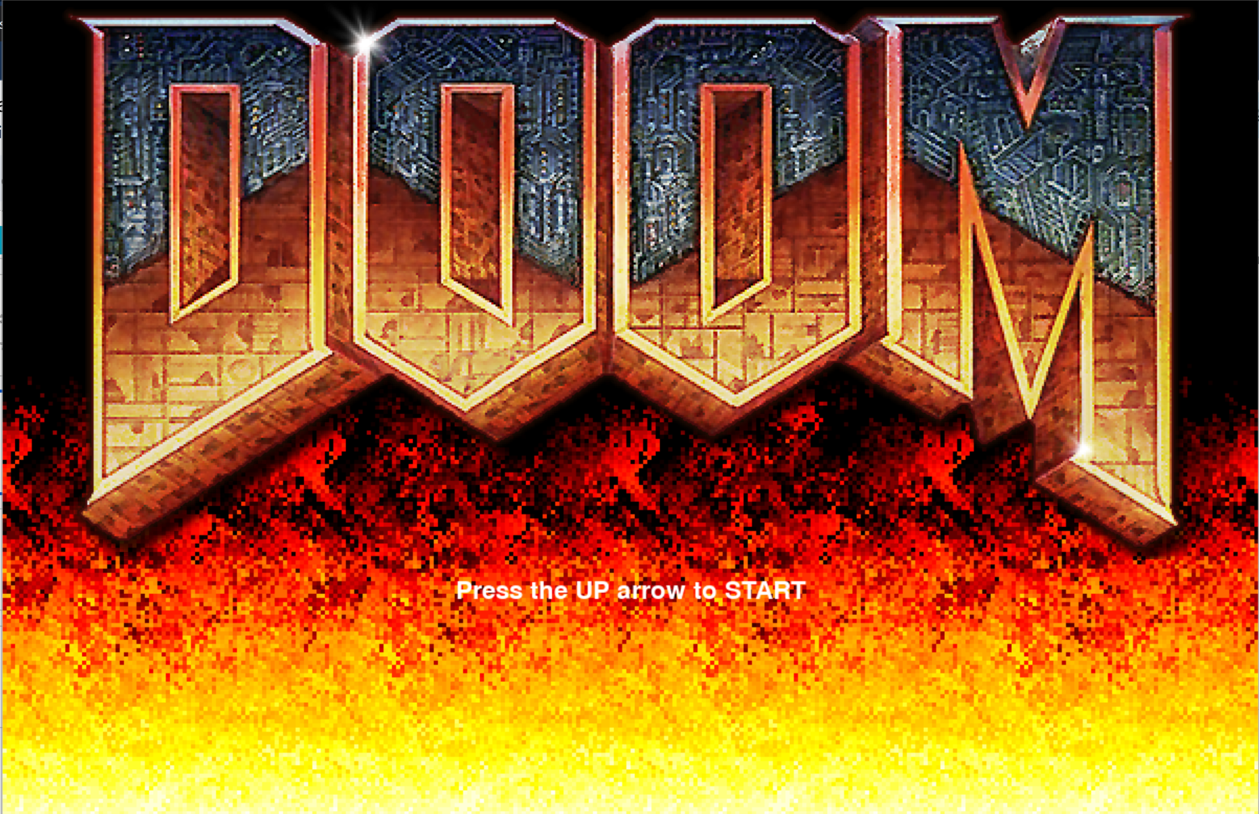
Doom
Single Player First Person Shooter
Used pygame
Raycasting Algorithm
Map and features
Different Guns
NPC

Slide 3
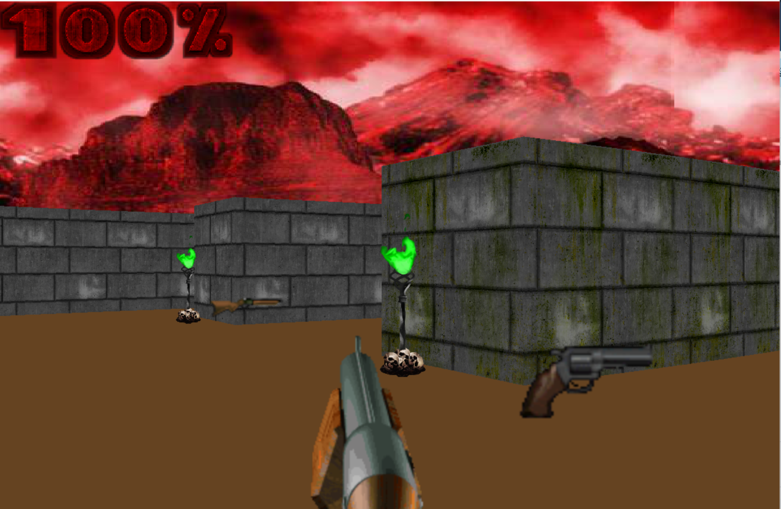
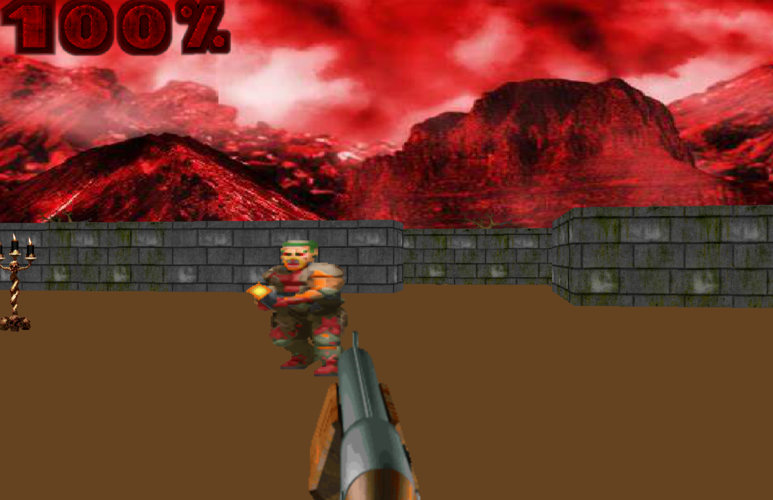
CHANGES MADE
The entire game was made and finished after midterm
Added more sprites around the map
Added different NPC’s

Slide 4
Future Plans
More levels
Pause Menu
Ammo drops
Melee
Transition to game engine
Ammo drops, powerup drops, and more misc item drops

Slide 5
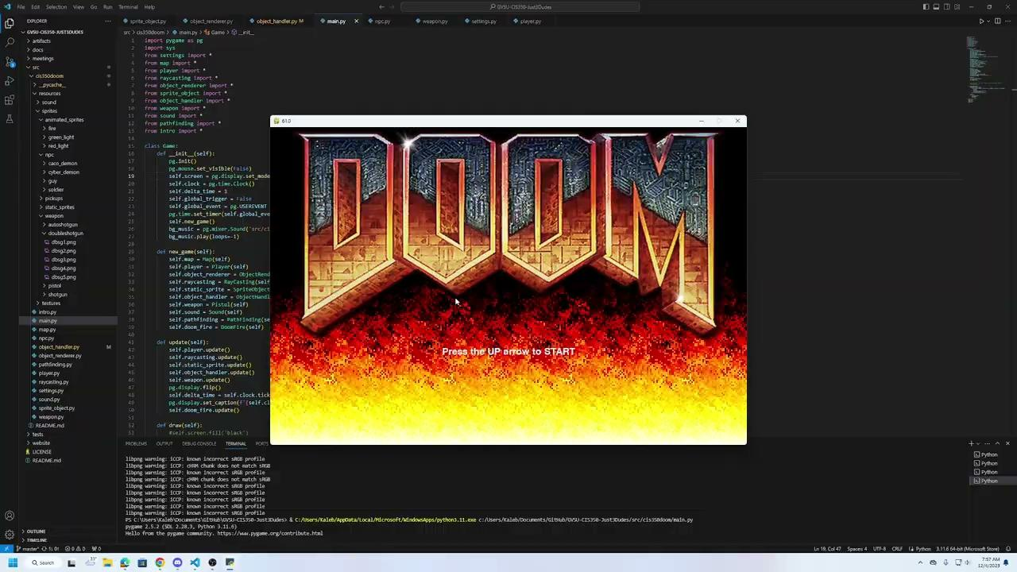
Demonstration
Process to run game
Clone our repo
Download pygame
Run main.py
Guns
Unique animation, animation time, and damage

Slide 6
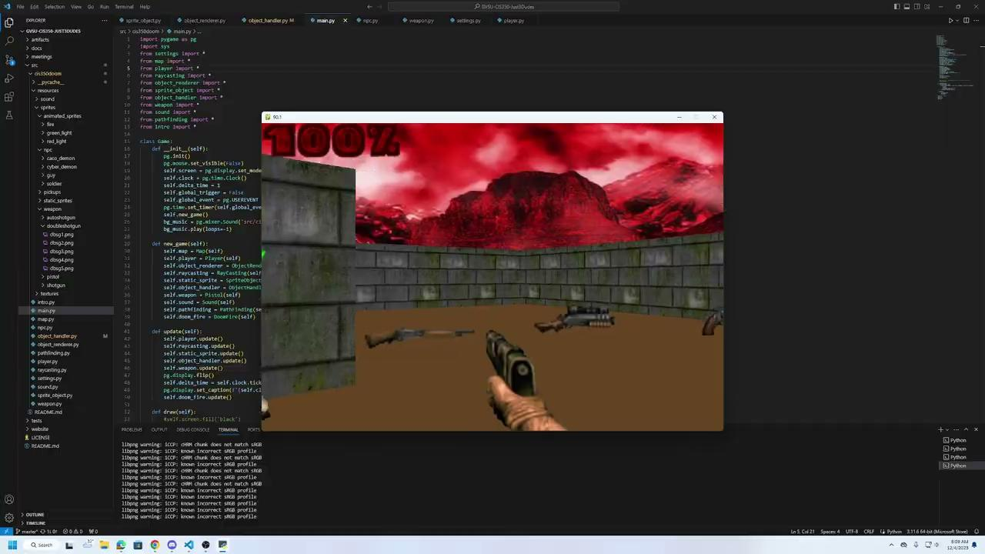
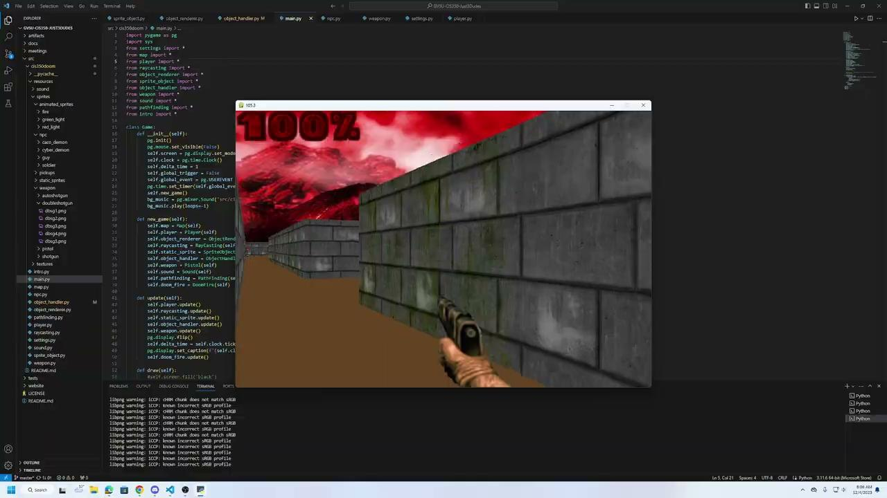
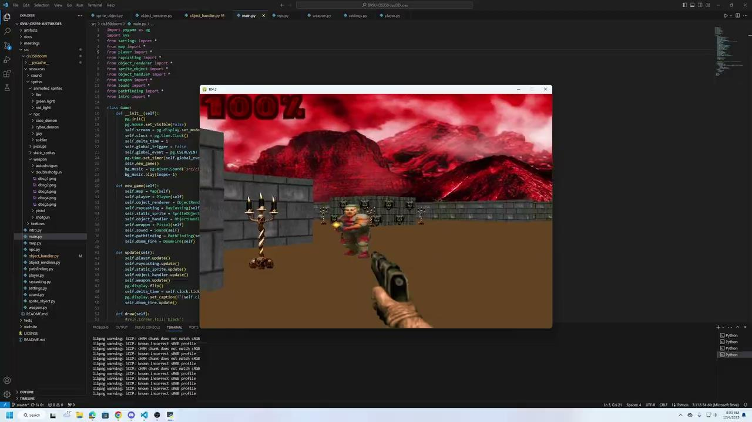
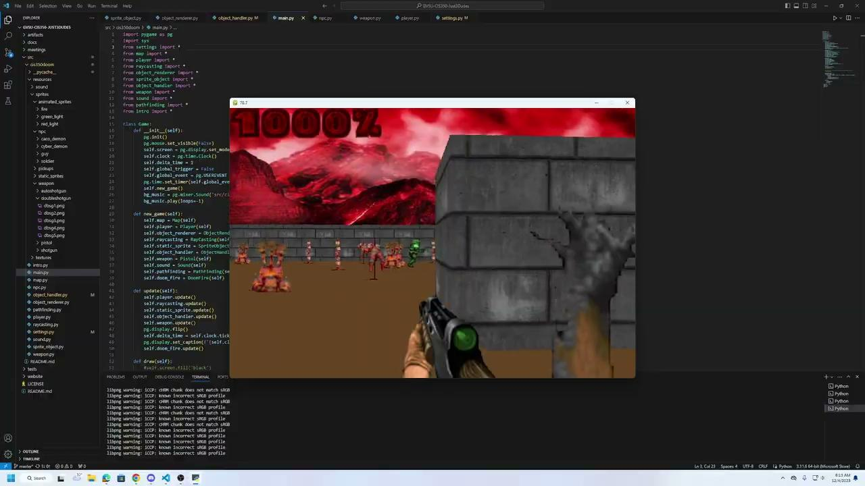
Demonstration
Cyberdemon
Cacodemon
Enemies
Unique animations, damage, health, attack distance, attack speed, and accuracy
On death every enemy will drop a healthpack which heals the player for a percentage of their current health
Soldier
“Guy”

Slide 7
Difficulties
Raycasting made adding in sprites difficult (They fly away in the air)
How the map is layed out makes adding sprites to specific spots you want tedious.
Pathfinding makes it so you cannot place enemies in certain spots

